Slide 1
Sources for Writing History of Ancient Bengal
“History is based on sources”
Constructing/re-constructing history of ancient Bengal is very difficult mainly because of the paucity of sources
Available sources mainly focuses on King and/or religion
Society and/or people are missing???

Slide 2
Major school of thoughts
Before addressing sources of history, we need to know some major school of thoughts of history of India in general and Bangladesh in particular. These are:
Nationalist Historiography
Marxist Historiography
Subaltern Historiography
Cambridge / British Historiography

Slide 3
Nationalist Historiography
Nationalist approach in Indian and Bangladesh History was taken to means as a motivating force of national awakening and made use of to inspire patriotic feelings;
National pride played a big role in providing inspiration to common people and historical consciousness began to grow steadily as never before;
Reinterpretation(s) of History: ‘The Revolt of 1857’ renamed as the first ‘Indian War of Independence’; Siraj ud Daula: A hero?

Slide 4
Nationalist Historiography
Methodological weakness
“In order to prove his thesis Jayaswal employed a large range of sources, but used them in a manner of a barrister trying to win a favourable judgment, emphasizing every passage which tended to support his case, and interpreting it in the most favourable light, while virtually ignoring the evidence which went against him.”

Slide 5
Marxist Historiography
The centrality of social class and economic constraints in determining historical outcomes are the key aspects of Marxist Historiography.
Analysis of explanation in terms of economic production and social classes have become basic tenets in historical construction.
It also known as Historical Materialism.
Far less narrative and descriptive and more explanatory and interpretative;
Interdisciplinary methods are widely used

Slide 6
Marxist Historiography
Broadening the scope of history (from the state to society; from statesmen and soldiers to the people)
Critique of Western understanding

Slide 7
Subaltern Historiography
Subaltern Historiography focuses more on what happens among the masses at the base levels of society than among the elite.
A historiography of protest???
It challenges of both a) colonial or British Imperialist Historiography b) Indian nationalist historiography; and termed as elitist approach
Guha asserts that parallel to elite politics, there was a domain of people’s politics in which the principle actors were the subaltern classes and groups constituting the mass of the population.

Slide 8
Cambridge/British Historiography
The main tenets of the Cambridge School of Historiography is to study British Empire using the imperialist point of view.
Previously,
Indology and the recovery of Indian history
Study of ancient text and documents : Colebrooke and Max Muller
Discovery and study of old inscriptions, monuments and coins: Prinsep and Cunningham
British Imperialist Historians
The British Imperialist administrator historian

Slide 9
Key characteristics
Western assumption regarding India’s past is that
A static, unchanging society
Oriental despotism
Justification for the continuance of British rule
Dominance of the political element (not social or cultural; benevolence of British conquest and benevolence should continue)

Slide 10
Periodization of the History of Bangladesh
Mainly three categories:
Ancient Bengal (upto 1204)
Medieval Bengal (1204-1757)
Modern Bengal (1757- )

Slide 11
Why is there lack of historical chronicles in ancient Bengal??
The absence of historical chronicles in ancient Bengal can not be explained by stating that later invaders destroyed them wholesale.
It was more than that...
Are we interested to preserve our own history even today?

Slide 12
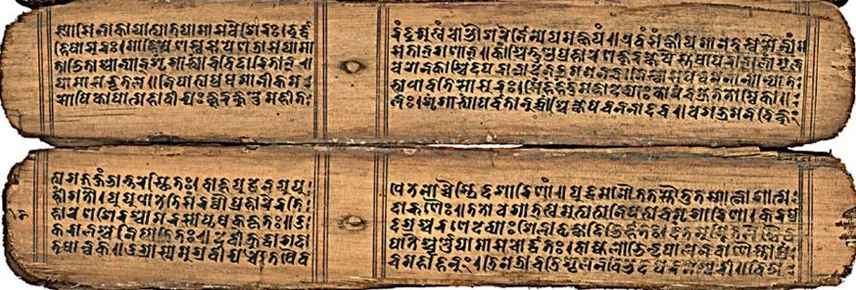
Two types of sources:
Archaeological sources
Literary sources

Slide 13
Archaeological Sources
Due to lack of literary sources, archaeological sources are vital for historians in reconstructing our ancient history;
Archaeological sources include:
Inscriptions
Ruins of cities
Monasteries
Sculptures
Terracotta plaques, other terracotta objects, and pottery

Slide 14
Archaeological sources:
“Inscription have been given the first place in the list because they are on the whole the most important and trust worthy source of our knowledge.” - Vincent Smith
The copper plate inscriptions and prasastis (eulogies) composed by royal court poets, archivists and genealogists are piece of historical writings;

Slide 15
Archaeological sources
A large number of inscriptions are found
Written in Sanskrit
Divided in two broad categories: official and private
The official records are mostly Prassastis of kings or land grants
Deopara inscription of VijayaSena is such an example

Slide 16
Archaeological sources
Deopara inscription was written by court poet Umapatidhara;
Land grants
Copper plate and in rare instances also found on stone pillars
What does it tell us?

Slide 17
Archaeological source
The Khalimpur Copper Plate is another famous inscription that tells us about several Pala such as: A) Devapala B) Rampala C) Dharmapala D) Mahipala I

Slide 18
Archaeological source
Coins
The symbol of sovereignty ????
Very basic information such as the name of a king, place, date, religion, relationship with other king/emperor;
Trade; basically economic history...

Slide 19
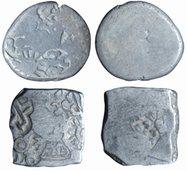
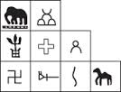
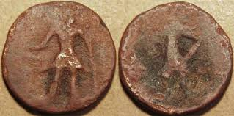
Coins
Punch marked coins
Cast copper coins
Imitation coins

Slide 20
Ancient Bengal
Maurya Period (3rd Century BC)
-- Mahasthangarh, Bogra
-- Brahmi inscription suggests strong administration, relief system (distribution of paddy and money)
-- First urban settlement
-- Arthasastra of Kautilya: fine cotton fabric
-- Thus famous muslin of Dhaka in 16th and 17th century is datables to Maurya period.

Slide 21
Material Remains
It helps to understand everyday life (mostly elite people???)
Economic and military strength of a kingdom
Religious belief
Material remains can be found in the shape of the ruins of ancient cities, terracotta plaques, sculptures and articles of everyday use.

Slide 22
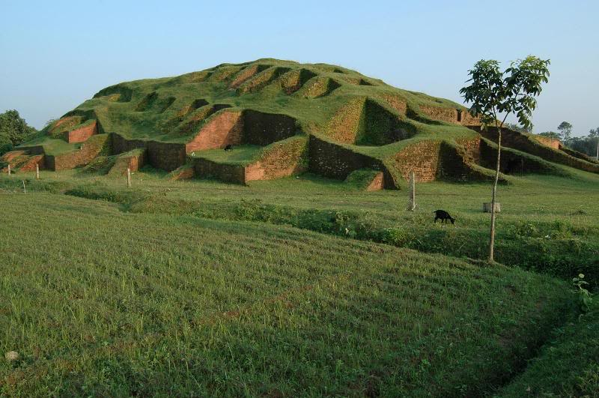
Material Remains
Some archaeological sites in Bangladesh are:
Mahasthangarh
Paharpur
Mainamoti
Somapura vihara and the like.

Slide 23
Written Sources
Literature
Overseas account
Documents
Literature:
a) Vedas, Mahabharata and Ramayana
b) Kautilya’s Arthasastro
c) Kalahan’s Rajatarangini

Slide 24
Arthashastra of Kautilya
Written in 3rd century BC
Refers to the fine cotton fabric of Vanga (south-eastern Bengal); beauty of women; and climate

Slide 25
Literature
Shandhyakaranandi’s Ramcharitam (1159 AD)
Aryamanjusrimulakalpa (8th Century AD)
Subhashita-ratna-kosa (the treasury of well-turned verses); edited by Biddakar/Sen
Saduktikarnamatra (Excellent sayings which are nectar for human hearing)/ edited by Sri Dhar Das/Sen
AryaSaptasati of Goverdhana Acharya

Slide 26
Literature
Overseas Account:
Greek and Latin Sources (3rd century BC - 1st century AD)
Gangaridae (Greek)
Gangaridai' (Latin)
located in parts of southern and southeastern Bengal, adjacent to the mouths of the Ganges (Bhagirathi and Padma)

Slide 27
Ptolemy
Greek Astronomer, Mathematician and Geographer
His book was Indica
Refers to a rich port named Tamralipti now in present Tamluk of West Bengal

Slide 28
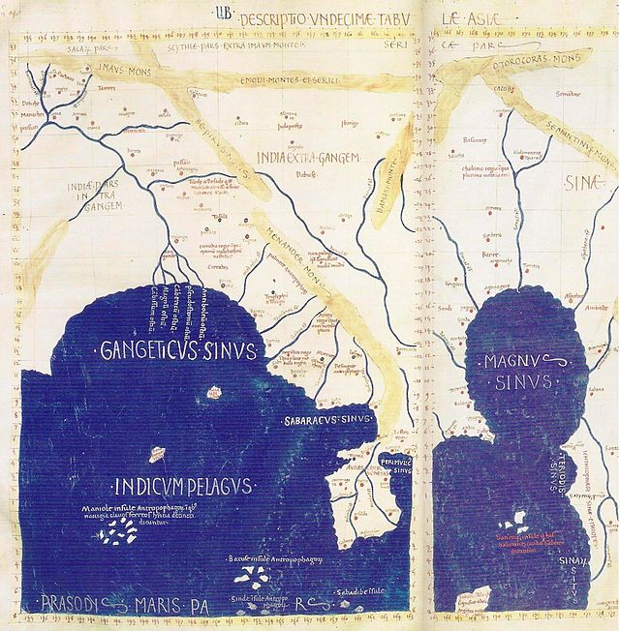
Detail of East and Southeast Asia in Ptolemy's world map. Gulf of the Ganges (Bay of Bengal) left, Southeast Asian peninsula in the center, South China Sea right, with "Sinae" (China).

Slide 29
Literature
Overseas Account
Fa-Hien (399 AD)
Hiuen- Tsang (c 630-638 AD)
Ibn Batuta (1338-1349 AD)
Lama Taranath (c 1608 AD)
Fairy tales/Hearsay/Strories

Slide 30
How did we get the Name Bangladesh ?
Earliest References to Bengal :
Bangladesh
Bangla
Bengal
Bengala
Bangala
Vanga
Vangal
Names of same geographical location as of present Bangladesh

Slide 31
Ancient Bengal
Maurya Period (3rd Century BC)
-- Mahasthangarh, Bogra
-- Brahmi inscription suggests strong administration, relief system (distribution of paddy and money)
-- First urban settlement
-- Arthasastra of Kautilya: fine cotton fabric
-- Thus famous muslin of Dhaka in 16th and 17th century is datables to Maurya period.

Slide 32
Ancient Bengal
Gupta Period (4th century AD)
-- Imperial rulers e.g., Samudragupta
-- Benevolent government and political stability.
-- Bengal became an imp. Province
-- Sea trade within India and outside India, shipbuilding.
-- Fa-Hsien visited Bengal.
-- Brahmin rulers patronised Buddhism.

Slide 33
Ancient Bengal
Janapadas :
For 1000 years between 600 BC - 400 AD Bengal was politically divided into several Janapadas or principalities
Pundravardhana : Mahasthangarh – Bogra
Varendra : Rajshahi - North Bengal
Vanga : Mymensingh - Dhaka - Faridpur - Barisal up to the Brahmaputra river

Slide 34
Ancient Bengal
Vangal : Probably southern part of Vanga near the sea
Samatata : Lalmai - Comilla including Tripura & Noakhali
Harikel : Chittagong – Sylet up to Comilla
Gaur : South of Murshidabad - Maldaha -- probably it included Birbhum & Burdwan too
Sumha - Radh : West Bengal

Slide 35
Ancient Bengal
Sasanka
-- First independent king of Gaur
-- Capital at Karnasubarna (Murshidabad)
-- Ruled from end of 6th / beginning of 7th century to 650.
-- Hsuen Tsang depicted Sasanka as anti-Buddhist.
-- Invaded Magadha (Southern Bihar) and forerunner of aggressive policy followed by Dharmapala.

Slide 36
Ancient Bengal
Matsanayam
period of anarchy between 650 – 750;
Following the century, after the death of Sasanka, Bengal saw very little of stable government and the whole country was torn by internal strife and disturbed by invasions from outside.
This found mention in the Pala records as state of matsyanyaya

Slide 37
Matsanayam
Matsanayam denotes, according to Kautiliya, “When the law of punishment is kept in abeyance, it gives rise to such disorder as is implied in the proverb of fishes, i.e., the larger fish swallows a small one, for in the absence of a magistrate, the strong will swallow the weak.”
Sources to construct history: Khalimpur copper plate and the account of Lama Taranatha

Slide 38
Ancient Bengal
Pala Dynasty (750-1097)
-- Founder Gopala,18 kings ruled for 400 years.
-- End of Matsanyayam
-- Golden age of Buddhism
-- Invasion towards North India by Dharmapala
-- Somepur Mahabihara,Paharpur, Rajshahi
-- Religious tolerance, art and sculpture

Slide 39
Pala dynasty
Gopala-I (c 756-781 AD)
Dharmapala(781-821)
Devapala (821-861)
Vigrahapala-I (861-866)
Narayanpala (866-920)
Rajyapala(920-952)
Gopala-II9952-969)
Vigrahapala-II (969-995)
Mahipala-I (995-1043)
Nayapala-I (1043-1058)

Slide 40
Pala dynasty
11. Vigrahapala-III (1058-1075)
12. Mahipala-II (1075-1080)
13.Surepala (1080-1082)
14. Ramapala (1082-1124)
15. Kumarapala (1124-1129)
16. Gopala III (1129-1143)
17. Madanpala (c.1143-1162AD)

Slide 41
Golden age ???
The long reign of the Palas form a glorious period in the history of ancient Bengal.
The dynasty ruled for about four hundred years, a rarity in the annals of dynastic history.
The achievements of Bengal during this long period are indeed the glories of the Palas. Widespread empire, organised administrative system, ruling policy oriented towards welfare of the people, unprecedented excellence in the field of arts and cultivation of knowledge and literatureall these are the achievements and glories of the Pala dynasty.

Slide 42
“In the beginning of the ninth century the Palas succeeded in spreading their sphere of influence up to Kanauj, if not over the whole of northern India, and this was Bengal’s first successful involvement in the politics of northern India. Though their hegemony in northern India did not last long, but it must be said that the power and strength that was generated during the early years of Pala rule, allowed them to hold their own against the aggressions of the northern Indian powers in the 10th and 11th centuries AD.”

Slide 43
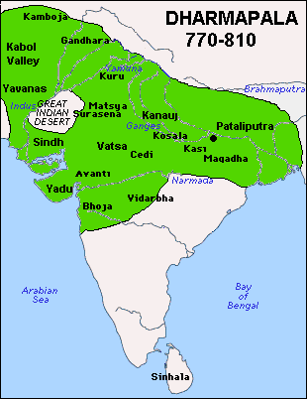
Pala Empire (dharmapala)

Slide 44
“The brightest aspect of Pala glories was manifest in the field of different arts. Distinctive achievements are seen in the arts of architecture, terracotta, sculpture and painting. The somapura mahavihara at paharpur, a creation of Dhamapala, proudly announces the excellence of the architectural art achieved in the Pala period. It is the largest Buddhist Vihara in the Indian subcontinent and the plan of its central shrine was evolved in Bengal. In the Nalanda inscription of Vipulasrimitra it has been described as jagatam netraikavishrama bhu (pleasing to the eyes of the world).”

Slide 45
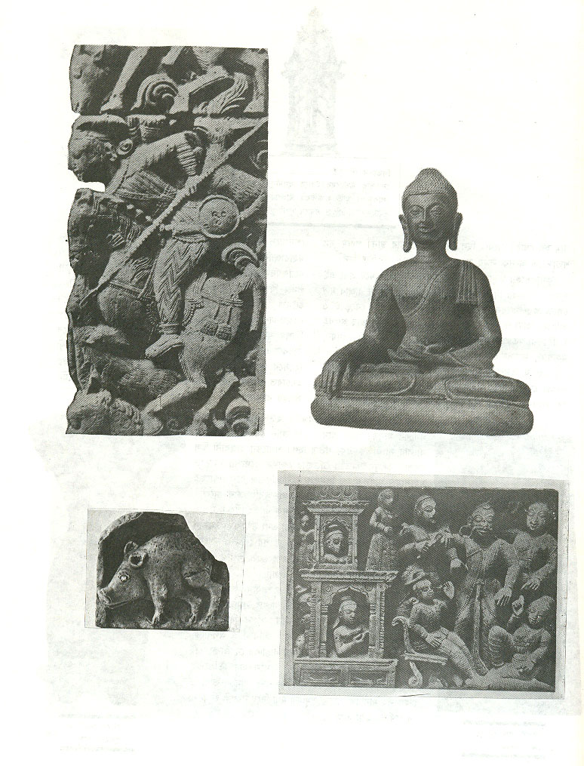
Pala art works

Slide 46
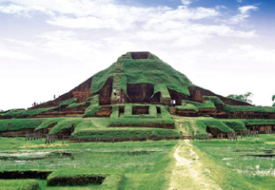
Somapura mahavihara, paharpur

Slide 47
http://www.youtube.com/watch?v=dBgdvipHmn4

Slide 48
Ancient Bengal
Sena Dynasty (1097-1225)
-- Founder Vijayasena defeating Palas.5 generation of kings e.g.,Vallalsena, Laksmansena
-- Sanskrit literature (Gitagovinda by Joydeb)
-- Caste system by Vallalsena.
-- Religious intolerance,Hindu orthodoxy, decline of Buddhism

Slide 49
Ancient Bengal
Dynasties of Southeastern Bengal
-- Maintained separate political entity despite attempts to intrusion.
-- Bhadra, Khadga dynasties existed in 7th century.
-- Deva dynasty was established in Mainamati-Lalmai area in 8th century.
-- Harikela was ruled by Chandra rulers in 9th century, evidence of sea trade, boat building etc found.

Slide 50
The sen rulers
Hemanta Sen (c. 1070–1096 AD)
Vijay Sen (c. 1096–1159 AD)
Ballal Sen (c. 1159–1179 AD)
Lakshman Sen (c. 1179–1206 AD)
Vishwarup Sen (c. 1206–1225 AD)
Keshab Sen (c. 1225–1230 AD)

Slide 51
Thank you
Farhana Afroz
Senior Assistant Professor
Bangladesh Studies Course

